Slide 1


RESTAURANT RATING
PREDICTION
HRISHABH V

Slide 2

1
Project Aim: Predict restaurant ratings using machine learning.
2
Objective: Help improve restaurant services and customer decisions.
3
Method: Use various features for prediction.
4
Impact: Enhance customer satisfaction and data-driven decisions.

Slide 3

Key Features of the Dataset:
Restaurant ID: Unique identifier for each restaurant.
Restaurant Name: Name of the restaurant.
Country Code: Numerical code representing the country.
City: City where the restaurant is located.
Address: Complete address of the restaurant.
Locality: Locality within the city.
Longitude: Geographical longitude of the restaurant.
Latitude: Geographical latitude of the restaurant.
Cuisines: Types of cuisines offered by the restaurant.
Average Cost for Two: Average cost for two people dining.
Currency: Currency used for pricing.
Has Table Booking: Indicator if the restaurant offers table booking (Yes/No).
Has Online Delivery: Indicator if the restaurant offers online delivery (Yes/No).
Price Range: Price range indicator (1 to 4).
Aggregate Rating: Overall rating of the restaurant.
Rating Color: Color code representing the rating.
Rating Text: Textual description of the rating (e.g., Good, Excellent).
Votes: Number of votes received by the restaurant.
DATASET

Slide 4
DATA PREPROCESSING
Handling Missing Values:
Identified and filled missing values in the 'Cuisines' column.
Encoding Categorical Variables:
Used one-hot encoding for categorical variables.
Load Dataset
Identify Missing Values
Impute Missing Values in 'Cuisines'
Encode Categorical Variables
Split Data into Training and Testing Sets

Slide 5
FEATURE ENGINEERING
Creation of Additional Features
Objective: Enhance model performance by creating new, relevant features.
Method:
Binary Columns for Cuisines:
Created individual binary columns for each type of cuisine.
Each column indicates the presence (1) or absence (0) of a specific cuisine.
Benefits:
Enables the model to understand the impact of different cuisines on ratings more effectively.

Slide 6
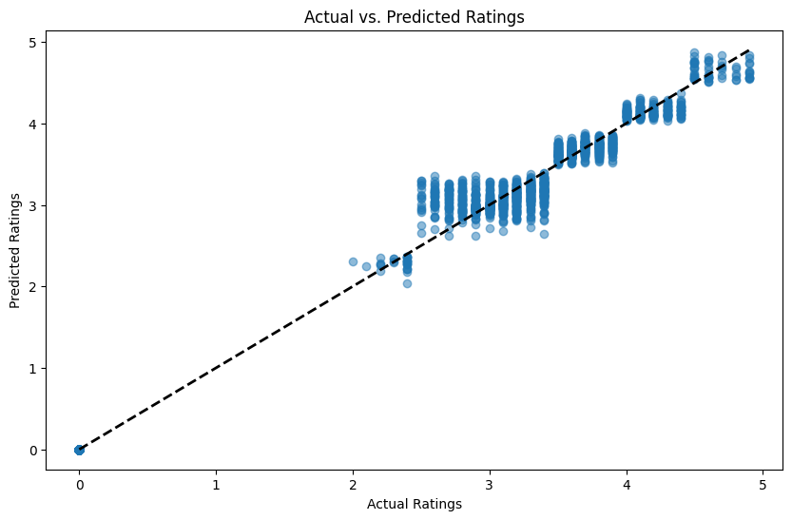
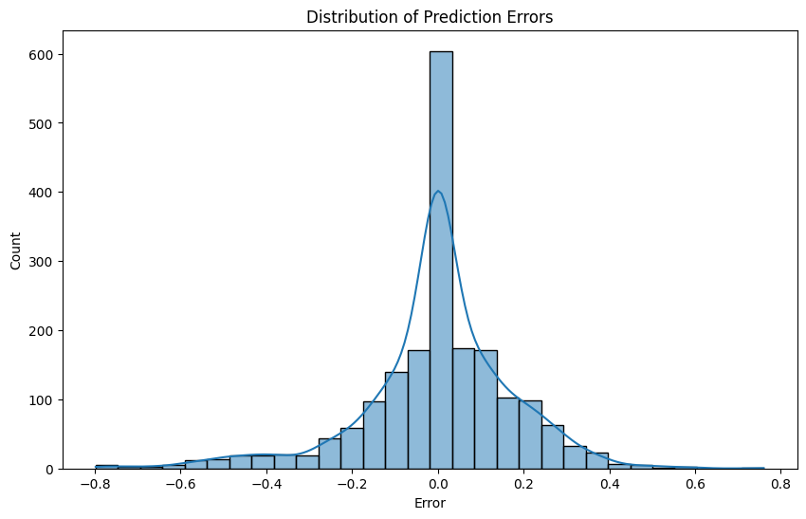
Exploratory Data Analysis
Actual vs. Predicted Ratings
This scatter plot shows how well the model's predictions align with the actual ratings. Ideally, points should cluster around the diagonal line, indicating that the predictions are close to the actual values.
Distribution of Prediction Errors
This histogram illustrates the distribution of errors (differences between actual and predicted ratings). A normal distribution around zero suggests that the model's errors are relatively small and evenly spread.

Slide 7
MODEL DEVELOPMENT
RANDOM FOREST
Ensemble Learning
ability to handle large datasets
robustness to overfitting
good performance on regression tasks

Slide 8

EVALUATION
MAE
MSE
R²
Measures the average magnitude of errors in the predictions, without considering their direction. It gives an idea of how close the predictions are to the actual values.
Measures the average of the squares of the errors, giving more weight to larger errors. It is useful for identifying how large the errors are
Indicates how well the model explains the variability of the target variable. A value closer to 1 indicates a better fit.

Slide 9
PREDICTION EXAMPLE
Feature | Value
Country Code | 162
Average Cost for Two | 2000
Has Table Booking | Yes (1)
Has Online Delivery | Yes (1)
Is Delivering Now | Yes (1)
Switch to Order Menu | No (0)
Price Range | 3
Cuisines | Japanese, Sushi
Predicted Rating: 3.26

Slide 10
SUMMARY
The Random Forest model performed well with an R² of [0.9862], MAE of [0.1169], and MSE of [0.0313].
Key insights revealed significant patterns in the data.
Next Step:
Enhance features and model tuning.

Slide 11
THANK YOU !

